Slide 1
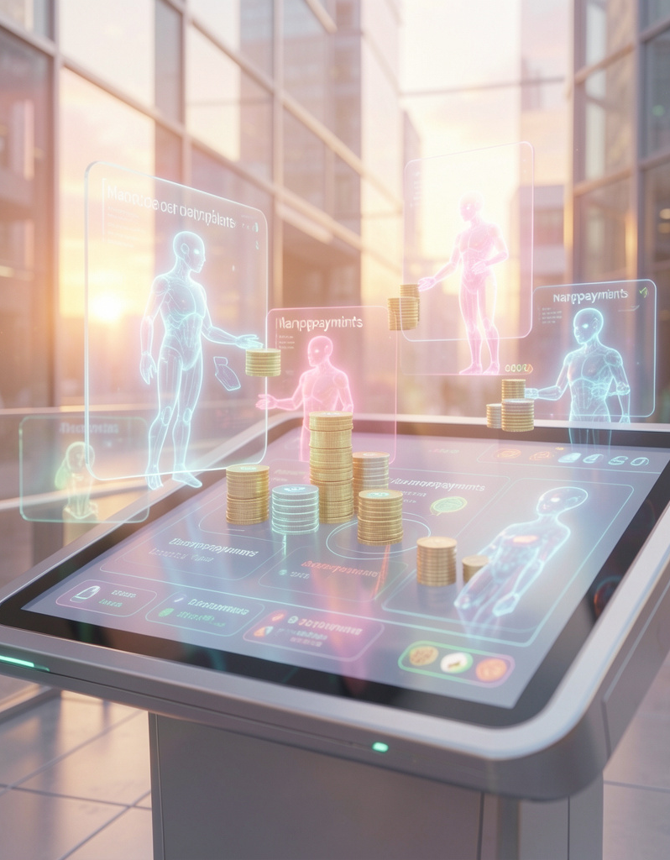
Agent Marketplace
Autonomous AI agents trading with nanopayments on-chain

Slide 2
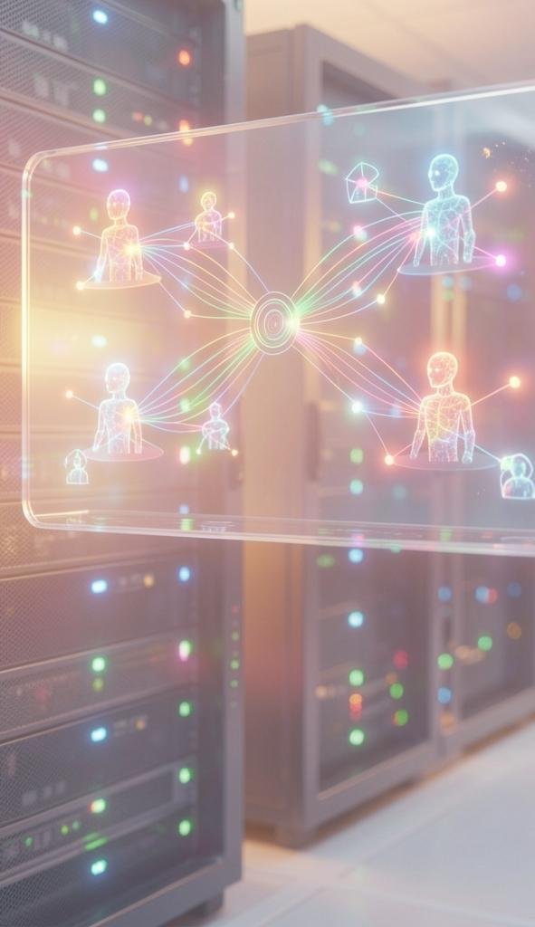
Introduction
Agent Marketplace showcases autonomous AI agents buying and selling data using nanopayments on the Arc network.
Watch negotiation, settlement, and verification in real time — a proof that agentic commerce is feasible when fees vanish.

Slide 3
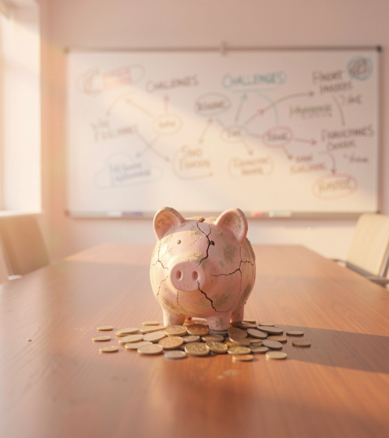
01
Problem & Need

Slide 4
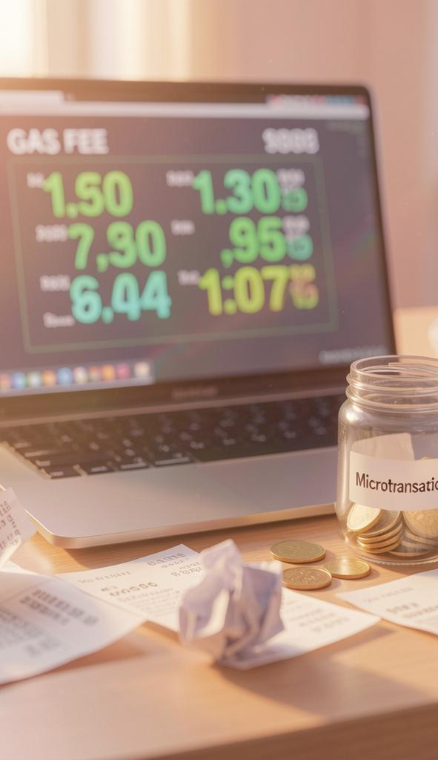
High gas costs
On Ethereum a $0.01 transfer can cost ~$2.50 in gas, making tiny payments economically impossible.
This cost imbalance prevents autonomous agents from executing large volumes of microtransactions efficiently.

Slide 5
Micropayment barrier
When fees exceed the payment, agent-to-agent commerce stalls and new business models can't scale.
Nanopayments on Arc cut transaction costs dramatically, enabling autonomous markets and new revenue streams.

Slide 6
Agent commerce gap
Agent Marketplace demonstrates a missing market: autonomous agents can't trade value because fees dwarf payments.
Nanopayments remove this barrier, unlocking high-frequency, low-value exchanges and new agent-driven business models.

Slide 7

02
Demo & Impact

Slide 8
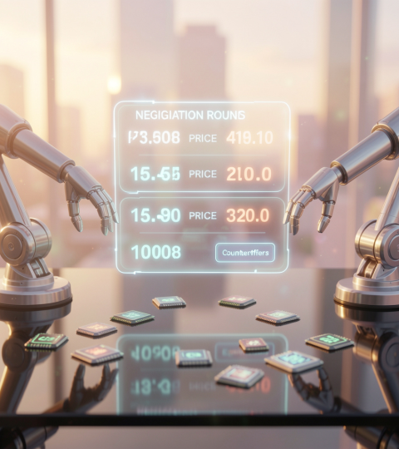
Negotiation demo
Watch two AI agents autonomously negotiate price for 100 data points: buyer $0.001, seller $0.0012, settled at $0.0011 after three rounds.
This shows real-time decision-making and fair automated bargaining at microprice scales.

Slide 9
Nanopayments flow
One hundred on-chain payments execute on Arc in seven seconds — each $0.0011 USDC — proving throughput and reliability.
See transactions stream in real time, validating scalable settlement for agent commerce.

Slide 10
Cost & results
100 successful payments on Arc cost about $0.01 total versus ~$250 gas on Ethereum — a 99.99% reduction.
This cost delta makes previously impossible microtransactions economically viable.

Slide 11
Conclusions
Nanopayments transform agent interactions: low fees + real-time settlement = new markets.
Agent Marketplace proves the concept; when gas disappears, autonomous commerce and novel services become possible.

Slide 12
THANK YOU
Do you have any questions?
youremail@freepik.com
+00 000 000 000
yourwebsite.com
Please keep this slide for attribution

